Slide 1
CSCE 5300 Project
The Predictive Analysis of Crop Recommendation using HADOOP and BIG DATA Submitted By - Group 8
Team Members:
1.Aditya Naga Venkatakrishna Chaitanya Kandregula 1161877
2.Anirudha Kulakarni Karanam 11656382
3.Mahaboob Ali Chisti Shaik 11647519
4.Surya Vamsi Chintapalli 11645442

Slide 2

INTRODUCTION
Agriculture is an important source of economic development. It is the backbone of the world’s economy and provides food, fibre and other essential resources to sustain life. Agriculture is still a well known occupation in many countries like India, USA, China, Brazil and etc.
The crop yield mainly depends on weather conditions i.e. Temperature and rainfall. Today youngsters are very much interested in farming system because the current status in Indian agriculture is very satisfactory and using latest technologies to make this agriculture more prestigious as the world’s economy is increasing year by year and the need of food is becoming more valuable .

Slide 3
In this project we gather and analyse various types of data related to agriculture such as temperature, rainfall data in selected regions. The aim of this datasets is to provide farmers with valuable insights that can help them improve the yield and quality of their crops.
By collection temperature and rainfall datasets, for example farmers can determine the best time to cultivate agriculture so that the farmers can get a good profit income.

Slide 4
Methodology
Data Cleaning
Data Processing
Data Visualisation

Slide 5

Methodology
DATA CLEANING:-
Data cleaning is a process to ensure that data is accurate, consistent while minimizing errors and inconsistencies that may arise from data entry.
Data Cleaning involves various tasks such as:-
Removing duplicate records.
Handling missing or null values by imputing or removing them.
Resolving inconsistencies between related datasets.
Standardizing data formats or units.

Slide 6
Methodology
In our project we have used Apache Spark to clean our data because Apache Spark is a tool used for data cleaning which improves our efficiency and scalability so that it will be easier to do our tasks when handling with large datasets.
DATA PROCESSING:- It involves different techniques and tools depending on the nature and complexity of the data and converts raw data into a usable format that can be analysed. For example, data processing for structured data may involve using SQL, while data processing for unstructured data may involve using machine learning algorithms.

Slide 7

Methodology
We have used Hive for data processing. Hive is a tool used for data processing large datasets using SQL queries.
It is also easier to load the data in Hive compared other data processing tools.
DATA VISUALISATION:- It is the process of representing data in a visual format, such as charts, graphs or maps to helps users understand and analyse complex data.
We have done our data visualisation in Excel spreadsheet because it is easy to use, accessible and widely adopted.

Slide 8
Methodology
We have used 3D bar graph in our rainfall and temperature datasets. A 3D bar graph is a type of chart that uses rectangular bars or columns to represent data in three dimensions.
The height of each bar or column represents a numerical value, while the width and depth represents categories or groups. In a 3D bar graph each bar is plotted along three axes: x-axis, y-axis and z-axis. The x-axis and y-axis represents the two categorical variables being compared while the z-axis represents the numerical variable being measured.
From rainfall dataset x-axis represents years, y-axis represents rainfall and the z-axis represents months.

Slide 9

Methodology
From temperature dataset, x-axis represents years, y-axis represents temperature and z-axis represents months.
We used Scattered graph and Bar graph in our rainfall and temperature dataset. A scattered graph is a type of chart that uses points or dots to represent the values of two variables.
Scattered graphs are commonly used in statistics, data analysis and scientific research to visualise the relationship between two variables.
Bar graph represents data using rectangular bars of equal width. It is commonly used in data visualisation to compare the values of different categories and groups.

Slide 10

TOOLS USED :-
HIVE
SPARK

Slide 11


Hive, Spark, and HDFS are all tools used in the field of big data and data processing.
Hive
is a Hadoop data warehouse and SQL-like query language tool for managing and analyzing structured and semi-structured data. It provides data analysts with a familiar interface and enables SQL-like queries, allowing them to access, manipulate, and analyze data using SQL-like syntax.
By using our data, we have Processed the data from excel sheet to table.
Temperature data set is processed from excel sheet to the table By using some of the queries we have added the annual season wise data added
Spark is a free and open-source data processing engine that enables distributed and fast data processing. It offers a unified engine that can handle a variety of workloads such as batch processing, real-time processing, machine learning, and graph processing.
Data cleanup
In the excel sheet there are null values by using Spark we can remove the null values and it used for processing .
We have removed the null values in the temperature and rainfall.

Slide 12
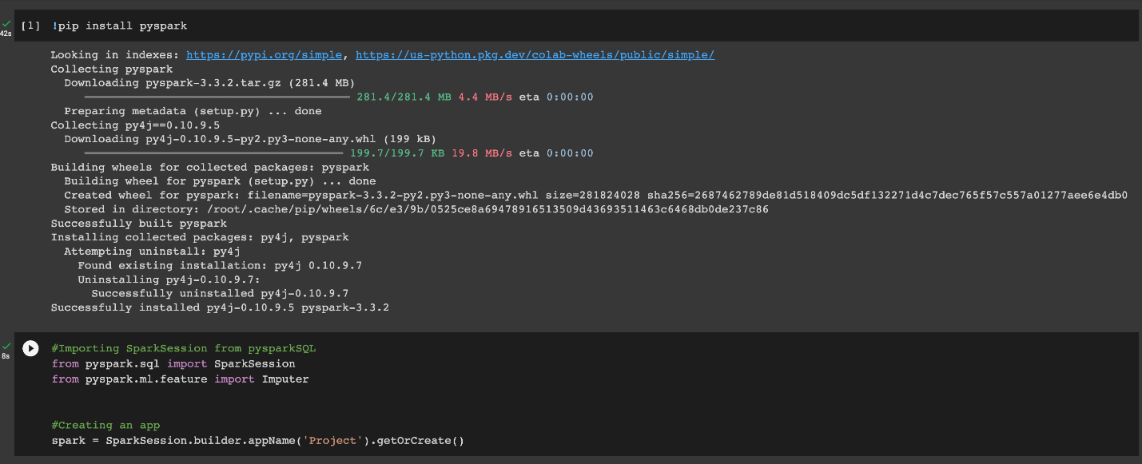
Analysis and Results
From above image we see that are installing pyspark with command “!pip install pyspark” in our notebook.
After installing “pyspark” we are importing “SparkSession” from “pyspark.sql” and “Imputer” is imported from “pyspark.ml.feature”.

Slide 13
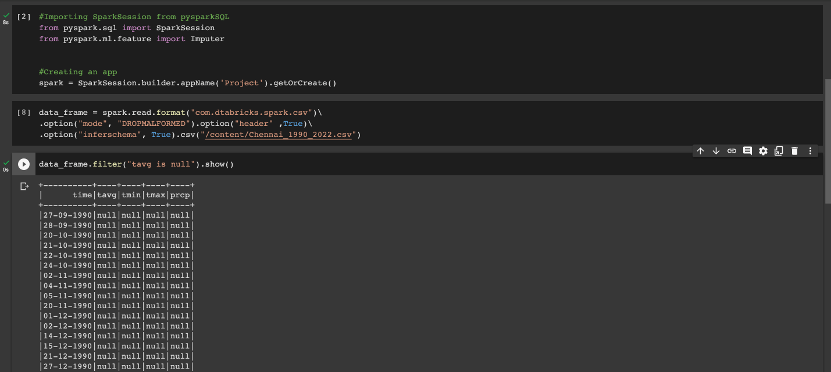
Analysis and Results
From the above image we are creating a dataframe from temperature data and displaying null values present in temperature dataset.

Slide 14
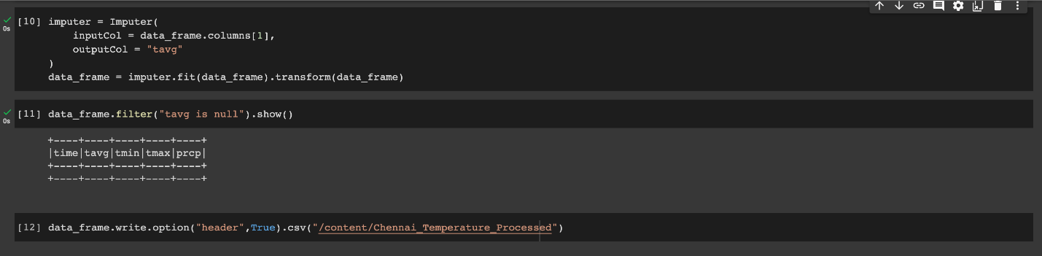
Analysis and Results
From the above image we see that we are replacing null values with mean of the column.

Slide 15
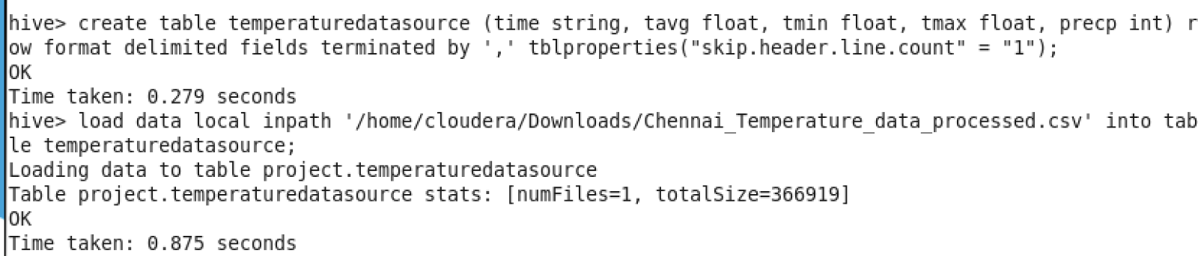
Analysis and Results
We have created a table with table name temperaturedatasource in Hive.
After successfully creating the tables I have given a path(load data local inpath ‘/home/cloudera/Download /Chennai_Temperature_data_processed.csv’ into table temperaturedatasource) to load the data to the given temperaturedatasource table.

Slide 16
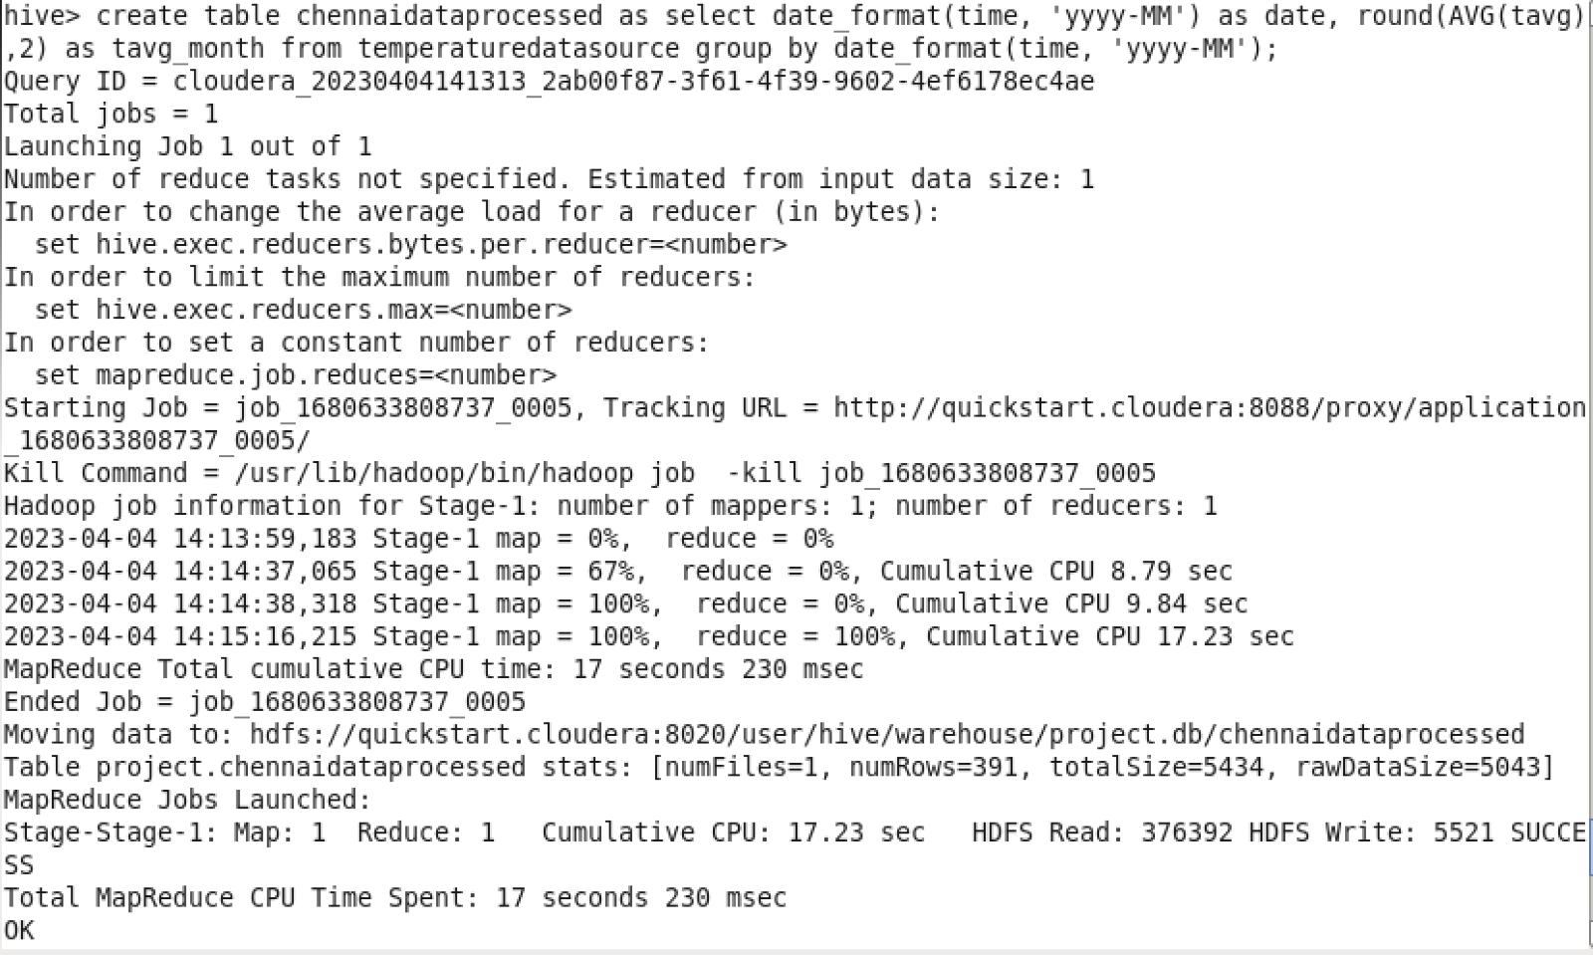
Analysis and Results
We have converted the data from daily to monthly using the above query.

Slide 17
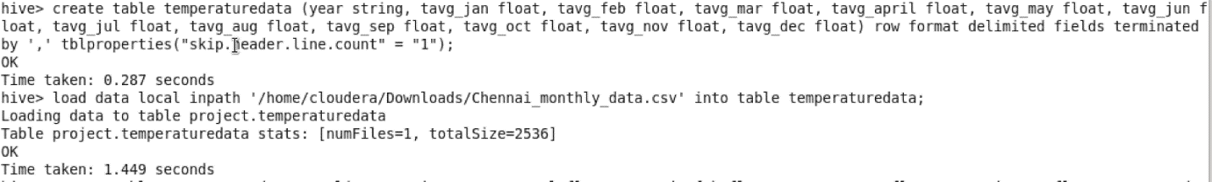
Analysis and Results
Here we have loaded the monthly dataset to newly created table with table name “temperaturedata”.

Slide 18
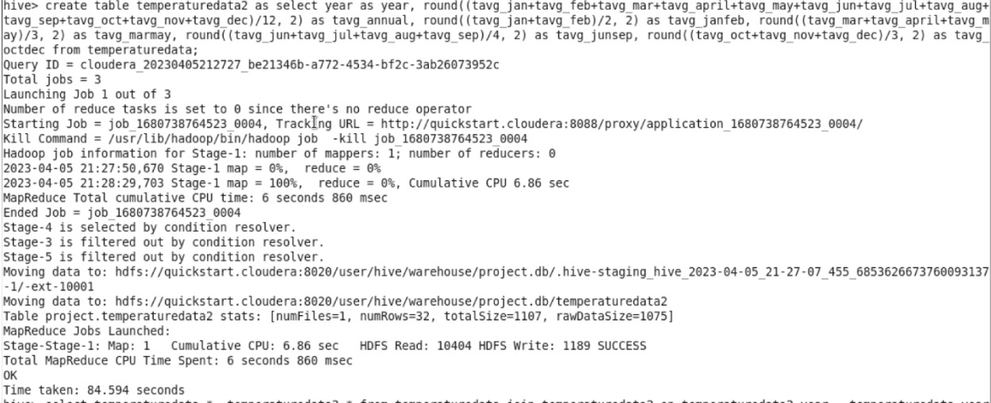
Analysis and Results
We have created a new table with annual and seasonal average of temperature data.

Slide 19
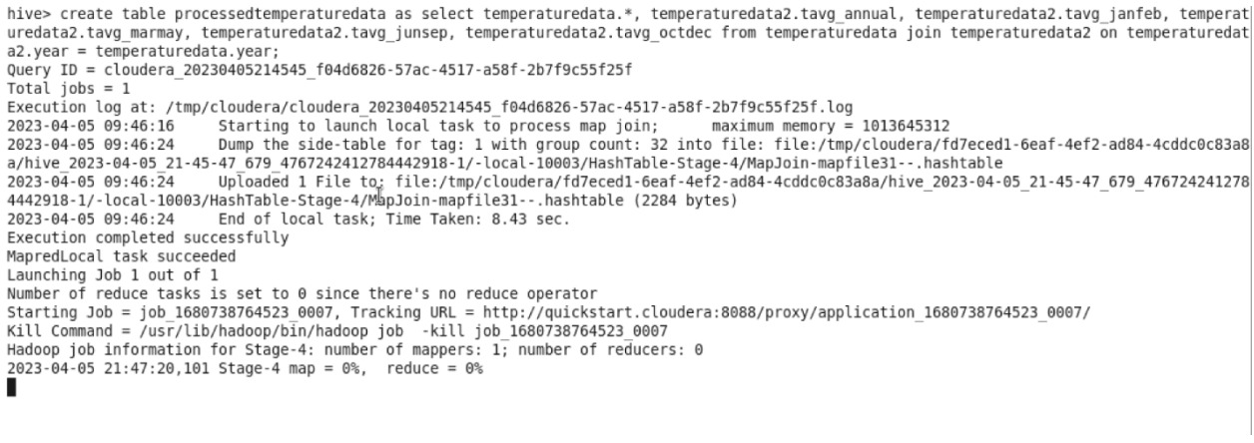
Analysis and Results
We have joined monthly data table and the missing columns data table.

Slide 20
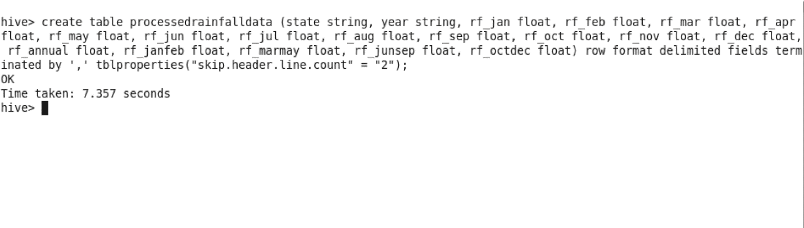
Analysis and Results
We have created the table with table name processsedrainfalldata in hive.
After successfully creating the tables I have given a path(load data local inpath ‘/home/cloudera/Download /rainfall_data.csv’ into table processedrainfalldata) to load the data to the given processedrainfalldata table.

Slide 21
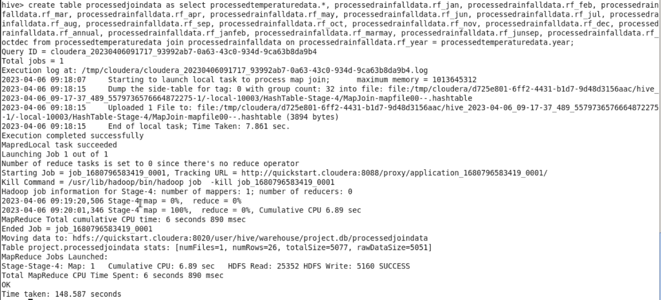
We have given a query to join the processed temperature and rainfall tables to get the combined data table.

Slide 22

Linear Regression Model
A machine learning algorithm built on supervised learning is linear regression. It completes a regression task. Regression creates a target prediction value based on independent variables. It is mainly used to determine how variables and forecasting relate to one another. Regression models vary depending on the number of independent variables they use as well as the type of relationship they take into account between the dependent and independent variables. The dependent variable in a regression has numerous names. It may be referred to as an outcome variable, criterion variable, endogenous variable, or regressand. The independent variables are also known as exogenous variables, predictor variables, or regressors.To comprehend and forecast the behavior of a specific variable, linear regression is used in a wide range of disciplines, including psychology, economics, and finance. For instance, in finance, linear regression may be used to comprehend the relationship between a company's stock price and its earnings or to forecast the value of a currency based on its historical performance.Regression is one of the most crucial supervised learning tanks. Regression uses a set of records with X and Y values to learn a function that can be used to predict Y from an unknown X. Regression requires us to find the value of Y, so we need a function that forecasts Y givenIn the case of regression, XY is continuous.Here, the terms "predictor variable" and "criterion variable" are used interchangeably. Regression can be done with a wide variety of functions or modules. The most basic kind of function is a linear one. In this case, X could be a single feature or several features combined to represent the issue.

Slide 23
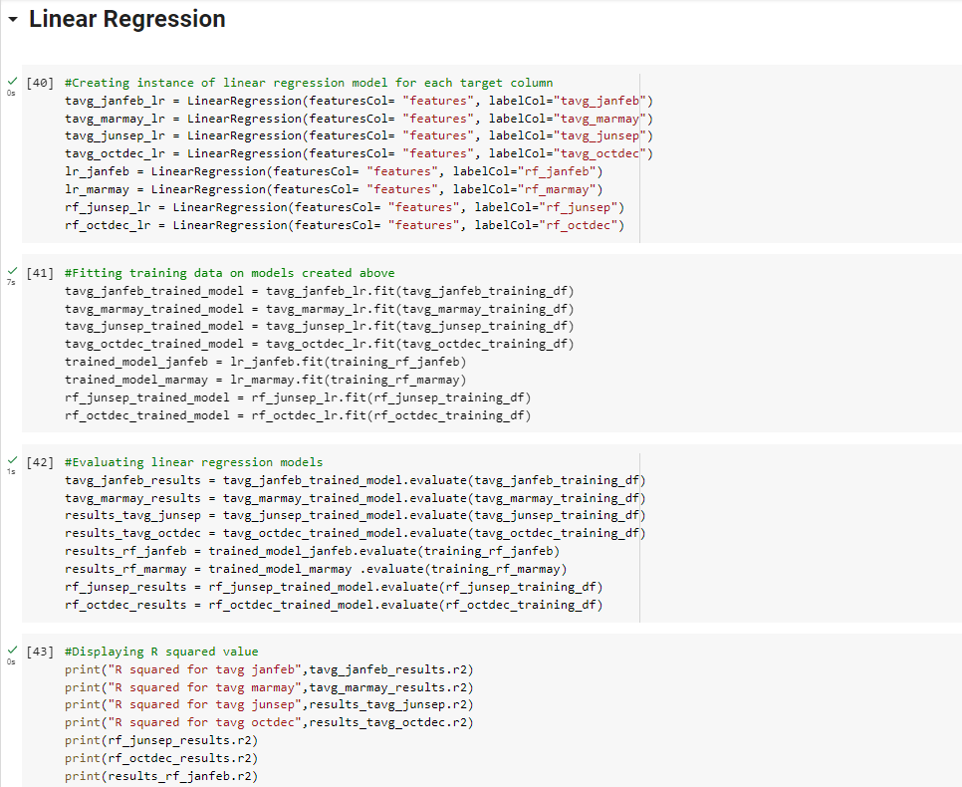

Slide 24
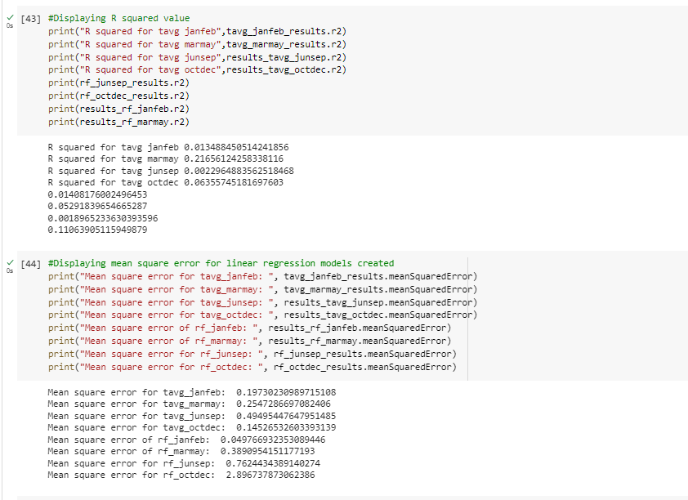
RESULTS & ANALYSIS

Slide 25
Decision Tree
Decision trees are a well-liked machine learning algorithm that can be applied to both classification and regression tasks. Those new to machine learning are the best option because they are simple to comprehend, interpret, and apply. All facets of the decision tree algorithm, including its working principles, various decision tree types, the method for creating decision trees, and methods for evaluating and optimizing them, will be covered in this thorough guide. You will fully comprehend decision trees by the time this article is over, along with how to apply them to solve problems in the real world.

Slide 26
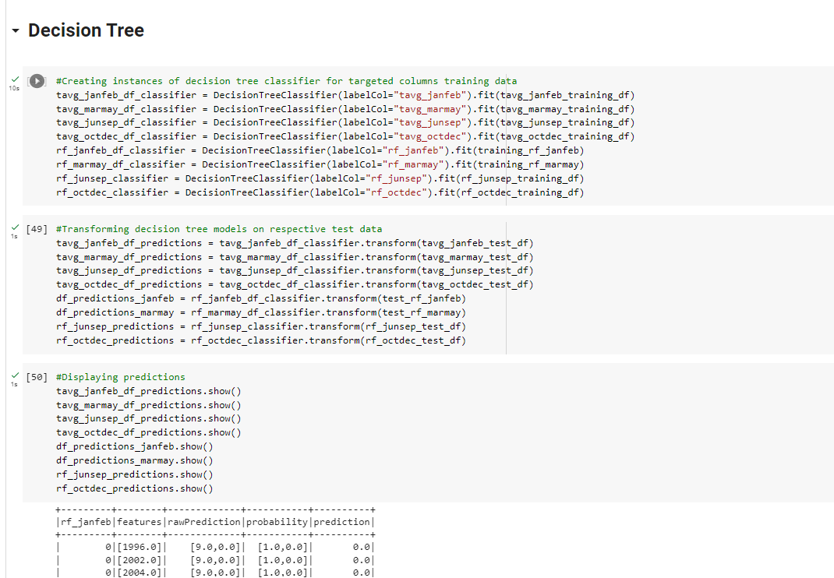

Slide 27
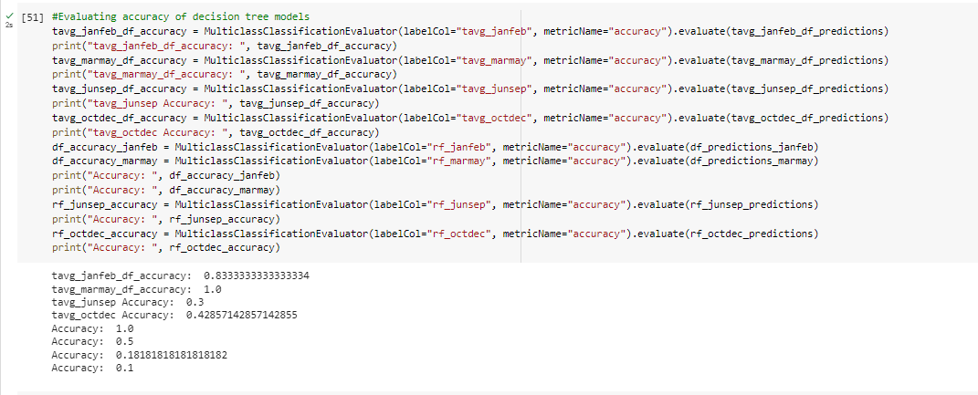
Evaluating the Accuracy of Decision Tree models

Slide 28
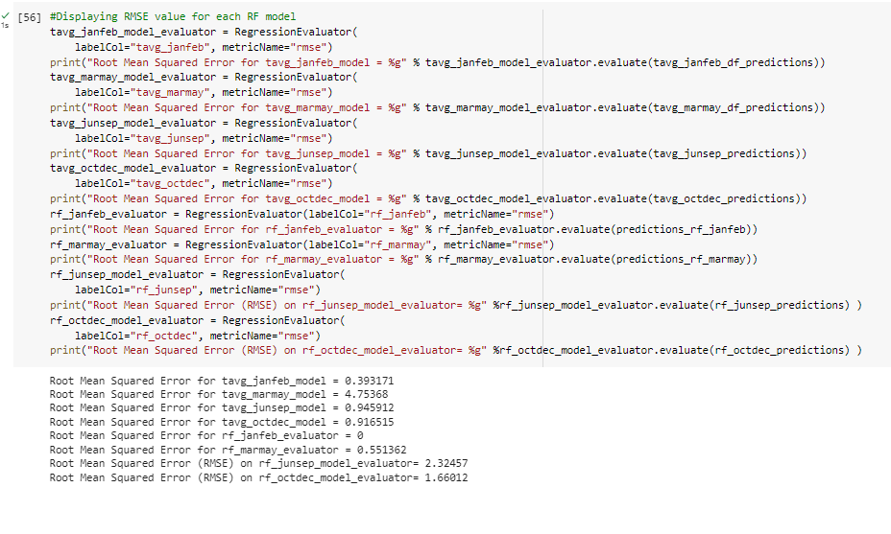
Displaying the Rise Value for Each RF Model

Slide 29

Mean Squared Error (MSE)
Mean Squared Error (MSE)The most popular and straightforward metric, MSE, has a small amount of mean absolute error variation. Finding the squared difference between the actual and predicted value is what is meant by mean squared error. Therefore, above we are determining the absolute difference, and here we are determining the squared difference. What the MSE actually stands for? It displays the squared difference between actual and anticipated values. In order to prevent the cancellation of negative terms, we square; this serves MSE well.

Slide 30

BENEFITS AND DRAWBACK’S
MSE benefitsBecause MSE's graph is differentiable, using it as a loss function is simple.MSE's drawbacksA squared unit of output is the value you obtain after performing the MSE calculation. For instance, if the output variable is in meters (m), the output we obtain from the MSE calculation is in meters squared.If the dataset contains outliers, the MSE calculation is larger because the outliers are penalized the most. In conclusion, it is not robust to outliers, which was a benefit in MAE.originating from sklearn.metrics import mean_squared_error print("MSE",mean_squared_error(y_test,y_pred))

